Slide 1
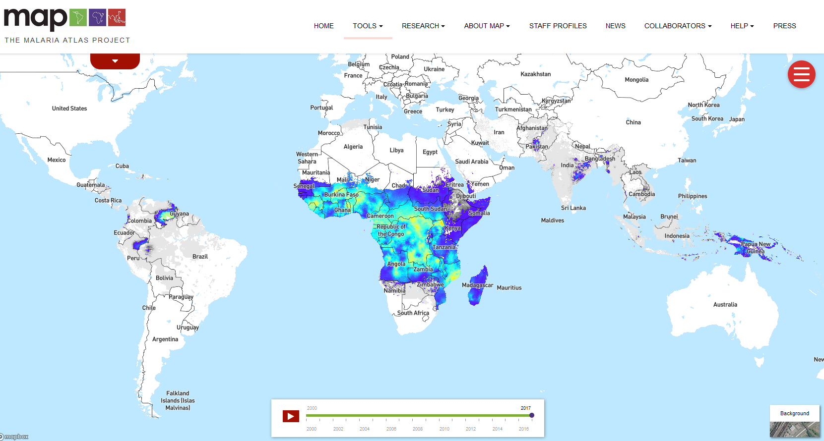
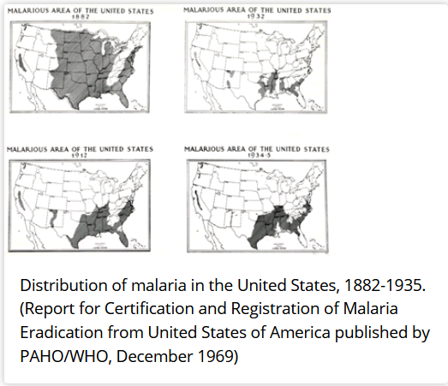
Introduction to malaria
https://www.cdc.gov/malaria/about/history/elimination_us.html
https://malariaatlas.org/explorer/#/
"It was a malaria-cursed desert, a barren wilderness swarming with poisonous snakes and repulsive reptiles (…) this was the resounding view of Florida in 1887"
"because of the risk of malaria, most insurance companies declined to provide life insurance below a latitude line of 30° south"
https://historyengine.richmond.edu/episodes/view/4215

Slide 2
Case study: Mass Drug Administration (MDA) vs Mass Screen and Treat (MST) in Burkina Faso
Mass Drug Administration (MDA)
Benefits:
Very effective at eliminating hard to identify parasite reservoirs (e.g., asymptomatic individuals)
Does not depend on the performance of screening method
Problems:
Wasting expensive antimalarial drugs (e.g., ACT) on malaria-negative individuals can be costly
Potential adverse effects of the drug
Overuse of ACT’s can lead to increased risk of resistance
(Valle et al., 2016; Millar et al., 2020)

Slide 3
Case study: Mass Drug Administration (MDA) vs Mass Screen and Treat (MST) in Burkina Faso
Mass Screen and Treat (MST) using RDT’s
Benefits:
May reduce the risk of emergence of resistance to antimalarial drugs
Might be more cost effective than MDA, depending on cost of the drug and the cost of screening
Problems:
Might lead to overtreatment and under-treatment
Effectiveness strongly depends on RDT performance and overall prevalence
(Valle et al., 2016; Millar et al., 2020)

Slide 4
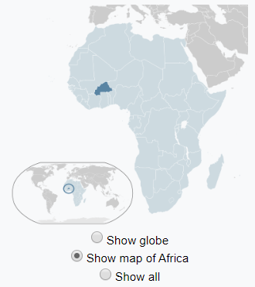
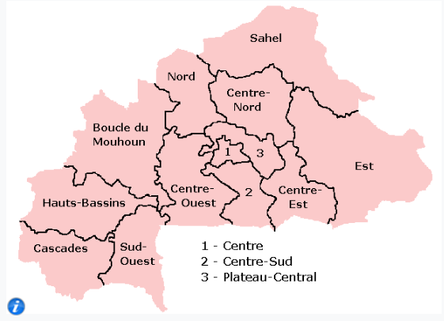
Burkina Faso
DHS data from Burkina Faso
Rainy season in 2010
6,510 children tested for malaria with
RDT and microscopy

Slide 5
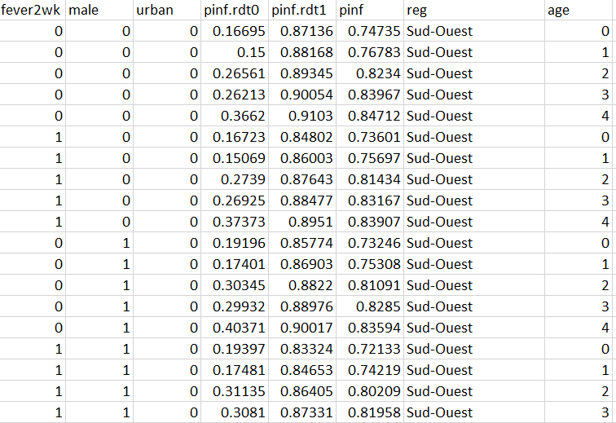
Modeling results
(Valle et al., 2016)

Slide 6
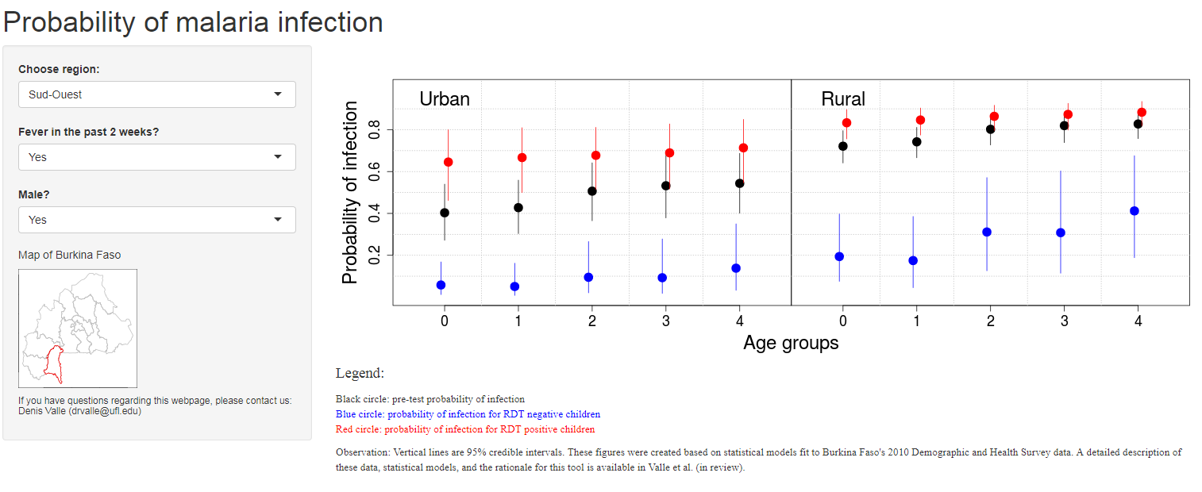
Interactive decision support tool I
https://denisvalle.shinyapps.io/burkina_faso_tool/
(Valle et al., 2016)

